Slide 1
On the Effectiveness of Random Testing for Android
or How I Learned to Stop Worrying and Love the Monkey
Priyam Patel Gokul Srinivasan Sydur Rahaman Iulian Neamtiu
New Jersey Institute of Technology

Slide 2
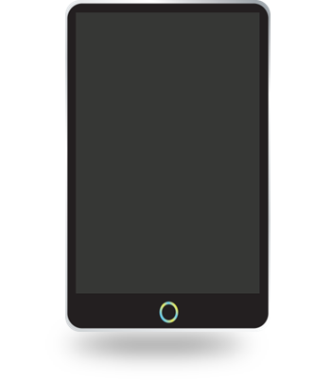
Motivation
Android runs on 85% of smartphones globally
More than 2 billion monthly active devices
Google Play, the main Android app store, offers more than 3 million apps
Android apps are updated on average every 60 days
Testing all these releases requires scalable, easy-to-use, portable, and effective tools

Slide 3
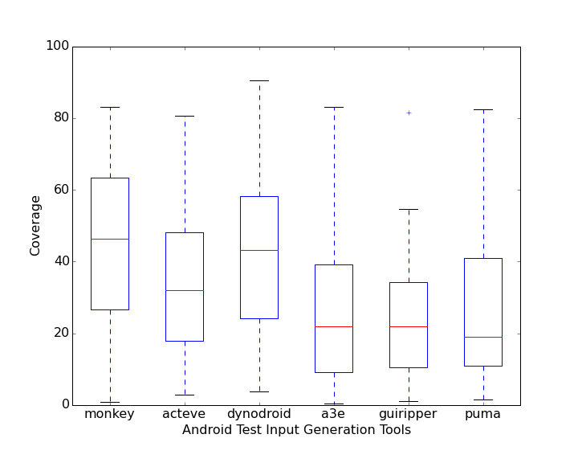
Monkey Beat All Android Testing Tools
Monkey
Dynodroid
ACTEve
PUMA
GUIRipper
A³E (our own prior work)
A prior study has compared the coverage attained by all those tools on 64 apps has shown that, on average, Monkey manages to achieve the highest coverage level across all the tools
02
S. Choudhary, A. Gorla, A. Orso. "Automated Test Input Generation for Android: Are We There Yet?" (ASE'15)

Slide 4
What is Monkey?
Monkey’s Default Events Distribution
Event | Description | Frequency (%)
TOUCH | single touch (screen press & release) | 15
MOTION | “drag” (press, move, release) | 10
TRACKBALL | sequence of small moves, followed by an optional single click | 15
NAV | keyboard up/down/left/right | 25
MAJORNAV | menu button, keyboard “center” button | 15
SYSOPS | “system” keys, e.g., Home, Back, Call, End Call, Volume Up, Volume Down, Mute | 2
APPSWITCH | Switch to a different app | 2
FLIP | Flip open keyboard | 1
ANYTHING | Any event | 13
PINCHZOOM | Pinch or zoom gestures | 2
Open source random testing tool
Runnable in physical device or emulator
Generates and injects random events
Watches for app crashing, exceptions throwing

Slide 5
Our Inquiries
1
Is stress-testing with Monkey an effective strategy for crashing apps?
4
Can manual exploration lead to higher coverage than Monkey’s?
Can Monkey be more effective (yielding higher coverage) when appropriately “tuned”?
2
5
Does inter-event time (throttling) affect
coverage?
Is coarse-grained (e.g., class/method) coverage indicative of fine-grained (e.g., block/line) coverage?
3

Slide 6
Question 1
“
“
Q: Is stress-testing with Monkey an effective strategy for crashing apps? Answer: Yes

Slide 7
APP | Installs (millions) | #Events | Time to crash (sec)
Shazam | 100-500 | 1,270 | 36
Spotify | 100-500 | 9,011 | 83
Facebook | 1,000-5,000 | 9,047 | 197
Whatsapp | 1,000-5,000 | 14,768 | 175
Splitwise | 1-5 | 819 | 12
UC Browser | 100-500 | 5,575 | 51
NY Times | 10-50 | 24,358 | 329
Instagram | 1,000-5,000 | 279 | 7
Snapchat | 500-1,000 | 4,676 | 24
Walmart | 10-50 | 6,510 | 56
MX Player | 100-500 | 1,742 | 41
Evernote | 100-500 | 8,733 | 91
Skype | 500-1,000 | 17,435 | 95
Waze | 100-500 | 7,261 | 38
Google | 1,000-5,000 | 1,220 | 34
Mean |  | 7,513 | 85
Application Crashes
it is not a matter of if, but when
Monkey manages to crash an app

Slide 8
Question 2
“
“
Q: Can Monkey be more effective (yield higher coverage) when appropriately “tuned”? Answer: No

Slide 9
Biasing Input Distribution
Coverage
Touch (75%)
Biasing leading to higher class coverage for some isolated cases only

Slide 10
Biasing Input Distribution
Mean across 64 apps
Coverage Type | Mean
 | Default | Touch (75%) | Motion (75%) | Trackball (75%) | Nav (75%) | Major Nav (75%)
Class | 50.7 | 49.3 | 49.9 | 47.1 | 48.0 | 48.5
Method | 40.8 | 39.7 | 39.8 | 36.5 | 38.1 | 39.2
Block | 36.9 | 35.7 | 36.4 | 32.5 | 34.1 | 35.6
Line | 36.7 | 35.5 | 35.1 | 32.0 | 33.7 | 35.0
Biasing ➔ mild decrease in coverage for all types (class, method, block, and line) only isolated/insignificant increases

Slide 11
Question 3
“
“
Q: Is coarse-grained (e.g., class/method) coverage indicative of fine-grained (e.g., block/line) coverage? Answer: Yes

Slide 12
Pairwise Correlation
Correlation Between Coverage Types: Class (C), Method (M), Block (B), and Line (L)
 | Touch |  |  | Motion |  |  | Trackball |  |  | Navigation |  |  | Major Nav
 | M | B | L | M | B | L | M | B | L | M | B | L | M | B | L
C | 0.93 | 0.91 | 0.92 | 0.95 | 0.78 | 0.82 | 0.97 | 0.94 | 0.96 | 0.98 | 0.96 | 0.96 | 0.97 | 0.93 | 0.95
M | - | 0.96 | 0.97 | - | 0.93 | 0.94 | - | 0.97 | 0.98 | - | 0.99 | 0.99 | - | 0.95 | 0.97
B | - | - | 0.99 | - | - | 0.99 | - | - | 0.99 | - | - |  | - | - | 0.99
Most correlation values > 0.9
This suggests a pragmatic approach for measuring coverage: low-overhead, coarse-grained coverage (class/method) is an accurate indicator of high-overhead, fine-grained coverage (block/line)

Slide 13
Question 4
“
“
Q: Within a 5-minute exploration time, does manual exploration achieve higher coverage than Monkey? Answer: Yes

Slide 14
Manual vs. Monkey Coverage
Mean coverage across 64 apps
Coverage Type | Mean
 | Monkey | Manual
Class | 52.4 | 54.7
Method | 42.2 | 45.0
Block | 38.6 | 42.5
Line | 38.1 | 41.6
Coverage
While manual exploration could be considered a "golden standard" at exploring an app thoroughly, we found that it might not to be the case for all apps

Slide 15
Question 5
“
“
Q: Does inter-event time (throttling) affect coverage? Answer: No

Slide 16
Varying Throttle
Line Coverage
Mean coverage across 64 apps
Throttle (msec) | Coverage
0 (Default) | 40.8
100 | 45.0
200 | 42.5
600 | 42.6
Throttle does not affect coverage significantly

Slide 17
Conclusions
Despite its simplicity, random testing for Android is effective
Reveals stress-related crashes
Coverage on par with laborious approaches such as manual exploration
Monkey's default event type distribution and settings are appropriate for achieving high coverage in a wide range of apps
Coarse-grained, class/method coverage is effective
Low-overhead, but indicative of finer-grained, block or line coverage

Slide 18
Thank you

